Slide 1
UML and SQL
http://www.tomjewett.com/dbdesign/

Slide 2
Models and Languages
Database design is a process of modeling an enterprise in the real world
Database is a model of the real world.
Some models or languages:
Entity-Relationship (ER) model is used in many database development systems. It can be represented in a graphic way.
Unified Modeling Language (UML): it is an object-oriented modeling language.

Slide 3
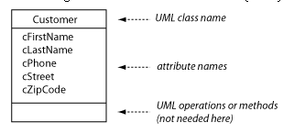
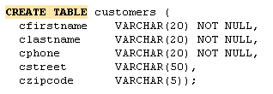
Classes and schemes
Class: A UML class (ER term: entity) is a thing that we would like to model.
E.g., in a student enrollment database, classes will be: student, enrollment, course.
Attribute (UML and ER, properties in OO languages): describing the features of members in the class.

Slide 4
Associations
Associations (UML) or relationship (ER) represents how two classes are functionally connected.
Multiplicity of the association (UML) vs. cardinality of relationship (ER)

Slide 5
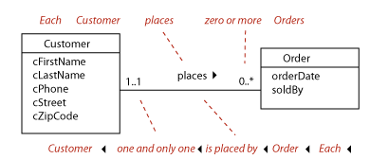
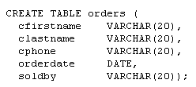

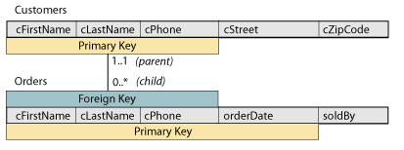

Associations
Each customer places zero or more orders, each order is placed by one and only one customer.

Slide 6
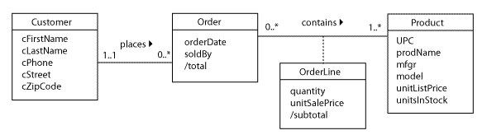
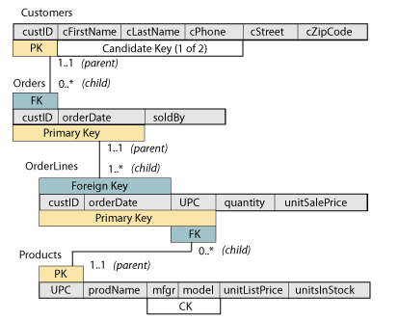
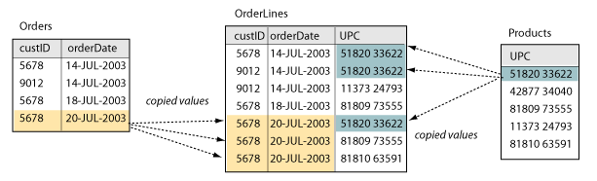
Association

Slide 7
Design Pattern: M:N
Business rules: Library Loan
A customer is any person who has registered with the library and is eligible to check out books.
A catalog entry is essentially the same as an old-fashioned index card that represents the title and other information about books in the library, and allows the customers to quickly find a book on the shelves.
A book-on-the-shelf is the physical volume that is either sitting on the library shelves or is checked out by a customer. There can be many physical books represented by any one catalog entry.
A loan event happens when one customer takes one book to the checkout counter, has the book and her library card scanned, and then takes the book home to read.
Each Customer makes zero or more Loans.
Each Loan is made by one and only one Customer.
Each Loan checks out one and only one BookOnShelf.
Each BookOnShelf is checked out by zero or more Loans.
Each BookOnShelf is represented by one and only one CatalogEntry (catalog card).
Each CatalogEntry can represent one or more physical copies of the same book-on-the-shelf.

Slide 8
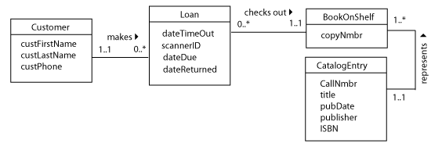
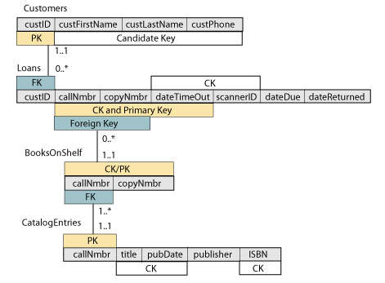
Design Pattern: M:N

Slide 9
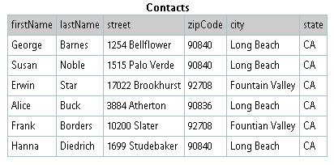
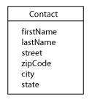
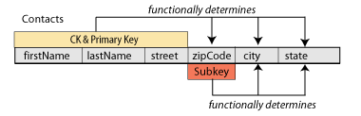
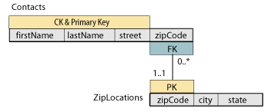

Design Pattern: SubKey

Slide 10
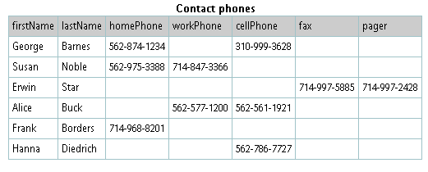
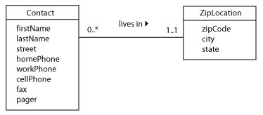
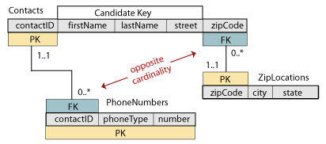
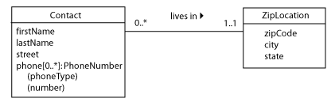
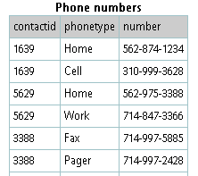
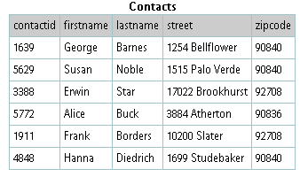
Design Pattern: Repeated Attributes

Slide 11
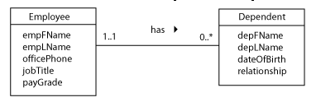
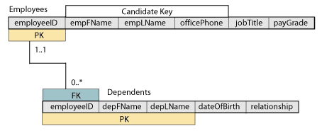
Design Pattern: Repeated Attributes

Slide 12
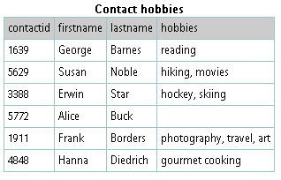
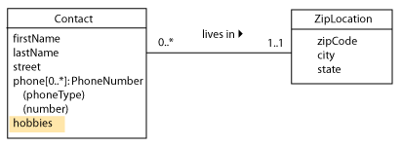
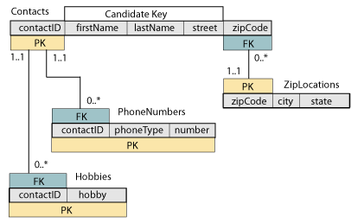
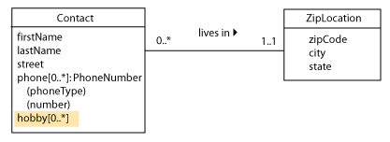
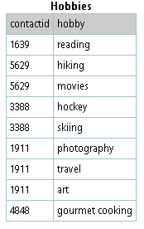
Design Pattern: Multivalued attributes

Slide 13
Design Pattern: Enumerated values
Some attribute values can be specified by a well-defined, reasonably-sized set of constant values (such as cities, colors, gender, states)
Look-up table (combo box, list box) will be a good way to go to avoid typos and keep consistency (easy for updating)

Slide 14
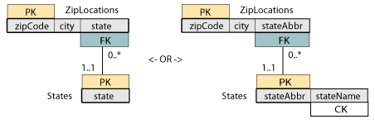
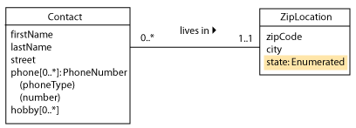
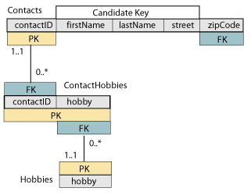
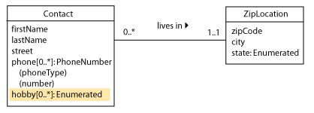
Design Pattern: Enumerated values

Slide 15
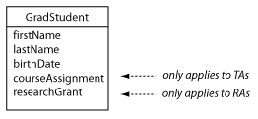
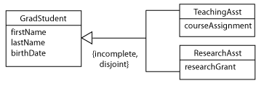
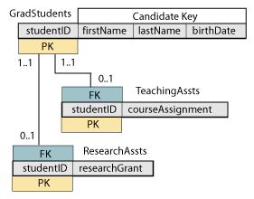
Design Pattern: Subclass

Slide 16
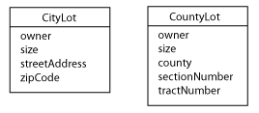
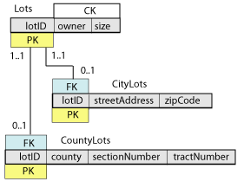
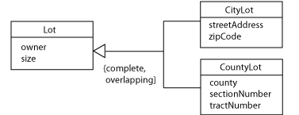
Design Pattern: Subclass

Slide 17
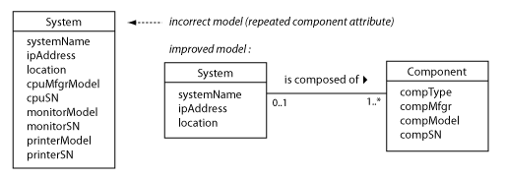
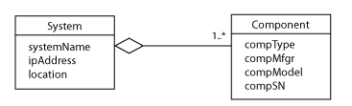
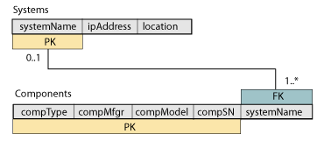
Design Pattern: Aggregation

Slide 18
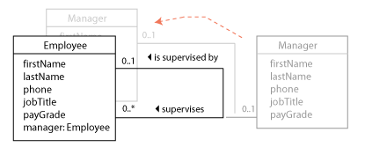
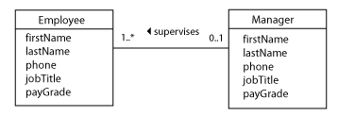


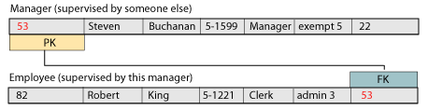
Design Pattern: Recursive association

Slide 19
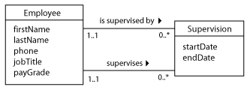
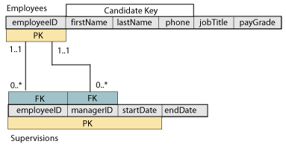
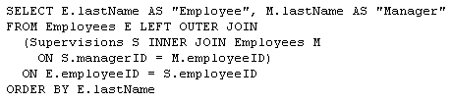
Design Pattern: Recursive association

